Slide 1


SMART INDIA HACKATHON 2026
Problem Statement ID - SIH26133
Problem Statement Title- Accessibility and Quality of Public Healthcare Services, particularly in rural and underserved areas
Theme- Medtech/ Biotech/ Healthtech
PS Category- Software
Team Number- 68
Team Name- Team Alpha

Slide 2
MAKE HEALTHCARE ACCESSIBLE ANYTIME AND ANYWHERE
TEAM ALPHA
Proposed Solution
How It Addresses the Problem
Innovation and Uniqueness
Rural Health Checkup
Vital Check : BP, Sugar, Temperature, Pulse
Local Language Support
Digital Prescription
Healthcare at Village Level
Quick Health Assessment
Less Travel to Hospitals
Easy Access to Prescription
Early Health Risk Detection
Accessible and Easy to Use
Simple Digital Health Record
Personalized Prescription Support
Local Language + Health Data
Rural-First Healthcare Model

Slide 3
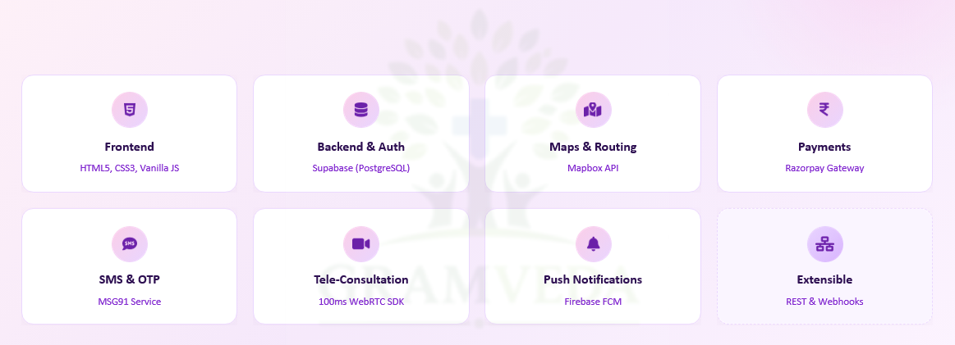
TECHNICAL APPROACH
TEAM ALPHA

Slide 4
FEASIBILITY AND VIABILITY
TEAM ALPHA
Analysis of Feasibility of the Idea
Uses existing resources: Connects available doctors, pharmacies, clinics and diagnostic centres instead of creating new infrastructure.
User-friendly: Designed with a simple interface so that even users with limited digital literacy can access healthcare services.
Potential Challenges & Risks
Poor internet connectivity in remote villages.
Availability of doctors may be limited in remote areas.
Strategies for Upcoming
Low-network solution: Design lightweight pages/app features that work with limited connectivity.
Doctor network: Partner with local doctors and hospitals and maintain scheduled consultation slots.

Slide 5
IMPACT AND BENEFITS
TEAM ALPHA
Early Intervention : Catches chronic conditions like cardiovascular diseases and maternal risks months before they become fatal emergencies.
Zero Income Disruption : Saves daily wage laborers from losing a day’s pay to travel to distant city hospitals for basic consultations.
Social : Democratizes quality healthcare access, drastically reducing the mortality rate gap between urban and rural citizens.
Economic : Lowers out-of-pocket medical expenditure by up to 60% through proactive prevention and cheaper local monitoring.
Environmental : Significantly minimizes carbon footprints by reducing fuel consumption associated with millions of medical trips from villages to tier-1 cities.

Slide 6
RESEARCH AND REFERENCES
TEAM ALPHA
National Health Mission (NHM) India Reports : Used data on rural doctor shortages and operational primary health centers (PHCs).
World Health Organization (WHO) Telemedicine Frameworks : Adhered to standard guidelines for mobile health (mHealth) and remote clinical assessments.
Ayushman Bharat Digital Mission (ABDM)
IEEE Research Papers

